Slide 1
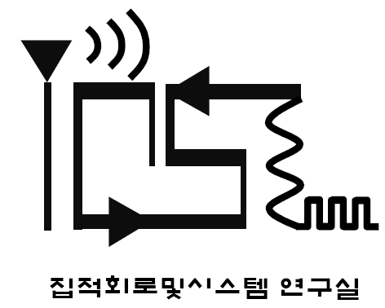
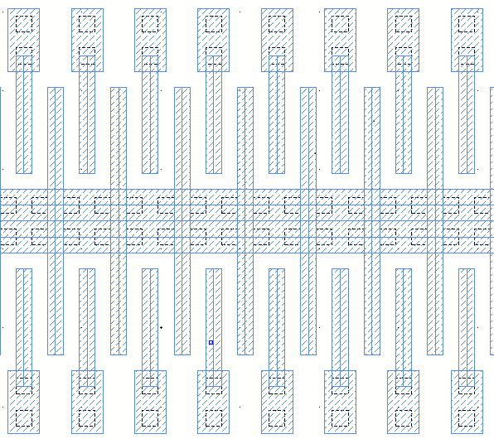
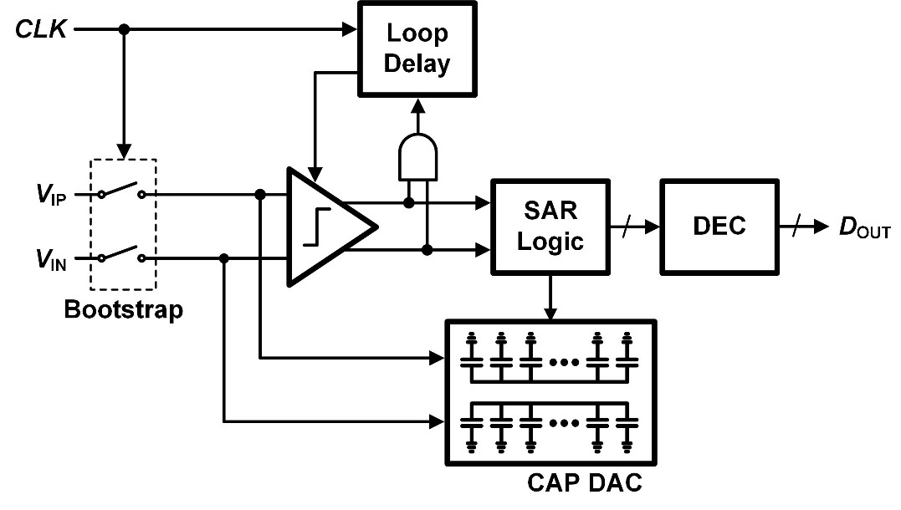
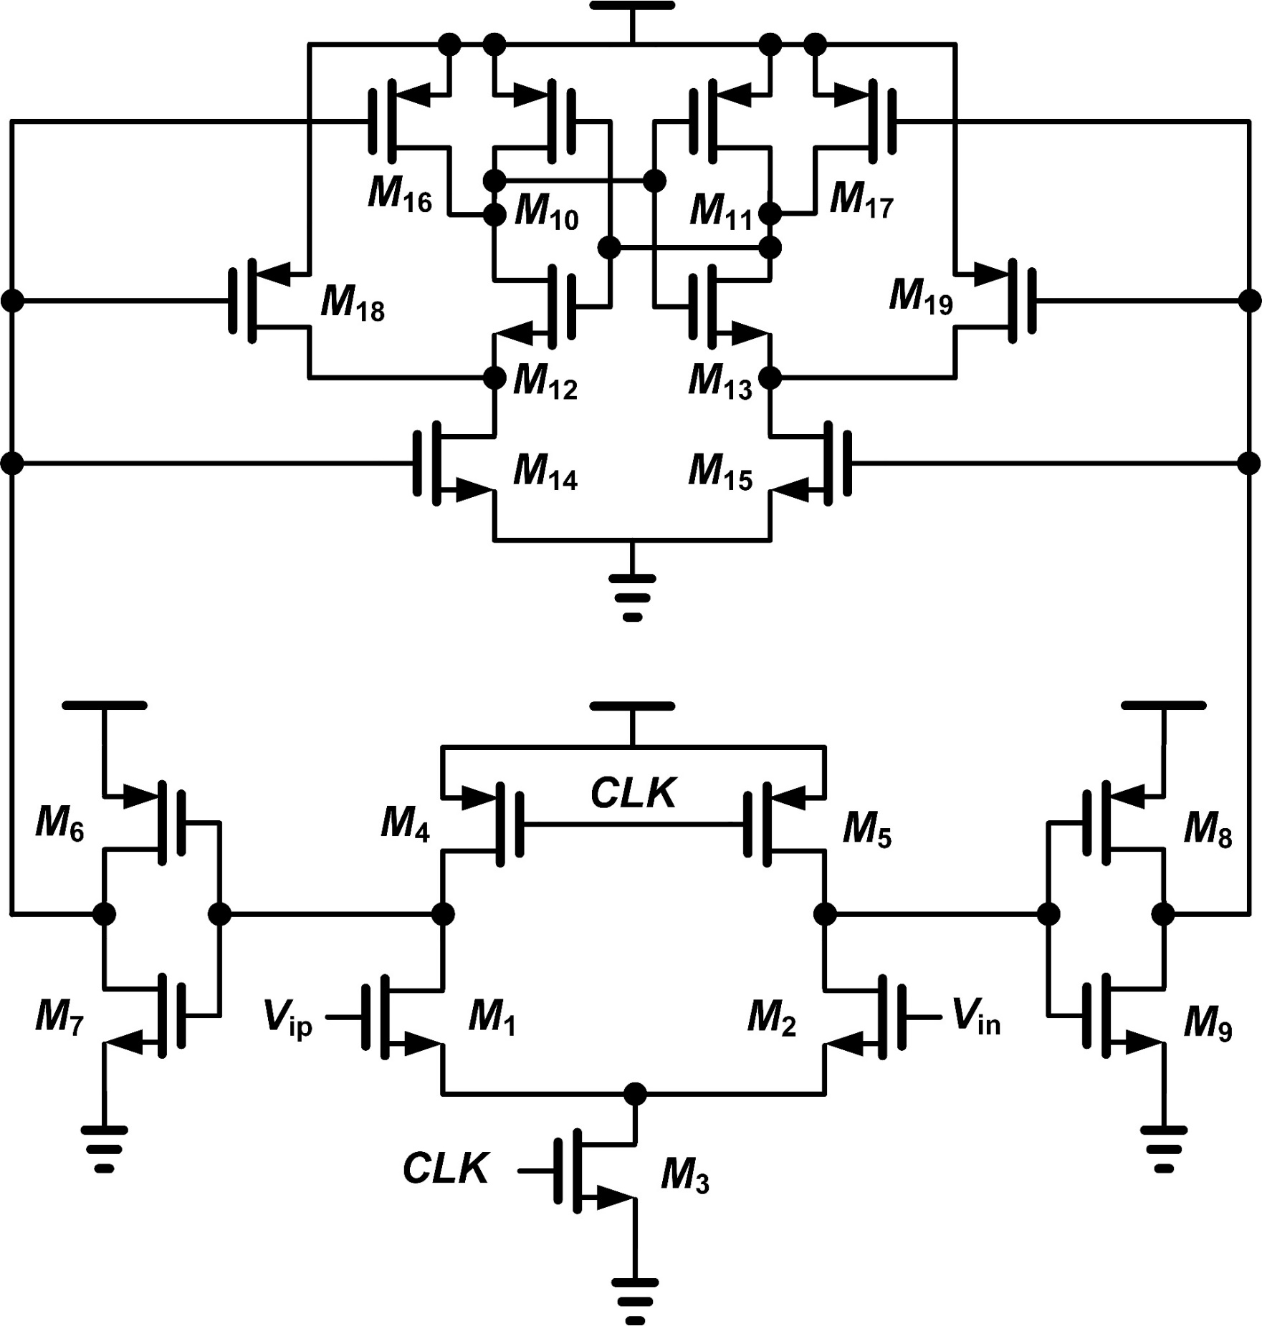
A Low-Power High-Speed SAR ADC
Sewon Lee and Minjae Lee
Integrated Circuits and Systems Lab.
Gwangju Institute of Science and Technology (GIST)
INTRODUCATION
CAPACITOR LAYOUT
Proposed Successive approximation Register(SAR) ADC is aim to have a operating frequency of several tens of MS/s with medium resolution for high speed application such as wireless communication and digital TV.
SAR ADC STRUCTURE
[ Capacitor DAC Layout ]
Metal 5 and 6 to minimize the parasitic capacitance.
0.4 fF as a unit capacitor.
SAR ADC LAYOUT
Positive Cap DAC
CAP DAC
Buffer
Loop Delay
[ Asynchronous SAR ADC structure ]
Bootstrap
Comp.
Adopting asynchronous architecture for achieving low BER.
Reference-less SAR ADC to diminish current consumption.
Negative Cap DAC
CAP DAC
Buffer
SAR Logic
COMPARATOR
[ SAR ADC Layout ]
Core ADC occupies 150-um height and 300-um width.
MEASUREMENT
 | This work | [1] | [2]
Technology | 65 nm | 130 nm | 90 nm
Sampling Rate (MS/s) | 30 | 50 | 50
Supply Voltage (V) | 1.2 | 1.2 | 1
Power (mW) | 1.1 | 0.826 | 0.7
Area (mm²) | 0.045 | 0.052 | 0.08
ENOB (bit) | 9.77 | 9.18 | 7.8
FoM (fJ/conv-step) | 42 | 29 | 65
ACKNOWLEDGMENT
The EDA tools were supported by IDEC, Korea
[ Dynamic comparator structure ]
[1] C. C. Liu, S. J. Chang, G. Y. Huang, and Y. Z. Lin, “A 10-bit 50-MS/s SAR ADC with a monotonic capacitor switching procedure,” IEEE J. Solid-State Circuits, vol. 45, no. 4, pp. 731–740, Apr. 2010.
[2] J. Craninckx and G. Van der Plas, “A 65 fJ/conversion-step 0-to-50 MS/s 0-to-0.7 mW 9 b charge-sharing SAR ADC in 90 nm digital CMOS,” in IEEE ISSCC Dig. Tech. Papers, Feb. 2007, pp. 24
Three-stage structure enhancing comparator gain.
Reducing input dependent kickback by first stage.

